Slide 1

IS2020 COMP 8157: Advanced Database Topics Lecture 02: The Relational Model and Calculus
Dr. Kalyani Selvarajah
kalyanis@uwindsor.ca
School of Computer Science
University of Windsor
Windsor, Ontario, Canada
May 20, 2020

Slide 2
Reference:
Database Systems: A Practical Approach to Design, Implementation, and Management, 6/E Thomas Connolly and Carolyn Begg

Slide 3
Relational Model Terminology
A relation is a table with columns and rows.
Only applies to logical structure of the database, not the physical structure.
Attribute is a named column of a relation.
Domain is the set of allowable values for one or more attributes.
Tuple is a row of a relation.
Degree is the number of attributes in a relation.
Cardinality is the number of tuples in a relation.
Relational Database is a collection of normalized relations with distinct relation names.

Slide 4
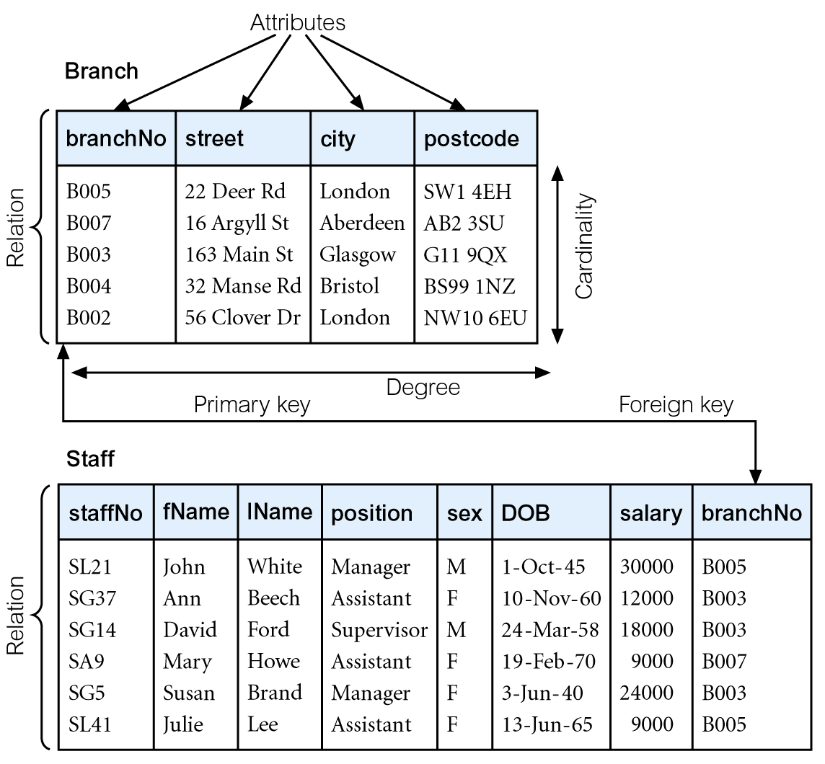
Instances of Branch and Staff Relations

Slide 5
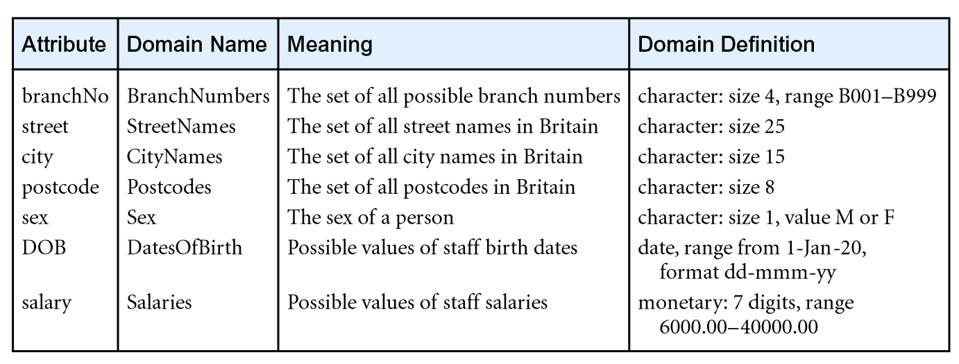
Examples of Attribute Domains

Slide 6
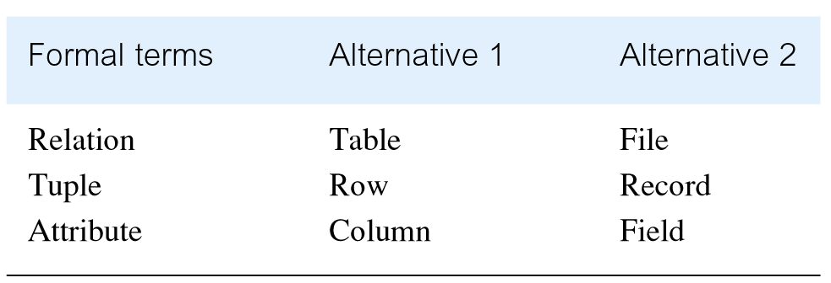
Alternative Terminology for Relational Model

Slide 7
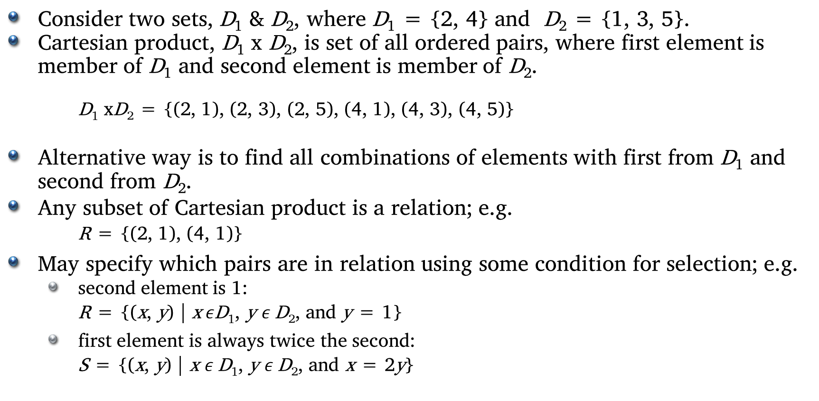
Mathematical Definition of Relation
Consider two sets, D₁ & D₂, where D₁ = {2, 4} and D₂ = {1, 3, 5}.
Cartesian product, D₁ x D₂, is set of all ordered pairs, where first element is member of D₁ and second element is member of D₂.
D₁ xD₂ = {(2, 1), (2, 3), (2, 5), (4, 1), (4, 3), (4, 5)}
Alternative way is to find all combinations of elements with first from D₁ and second from D₂.
Any subset of Cartesian product is a relation; e.g.
R = {(2, 1), (4, 1)}
May specify which pairs are in relation using some condition for selection; e.g.
second element is 1:
R = {(x, y) | x$ε$D₁, y $ε$D₂, and y = 1}
first element is always twice the second:
S = {(x, y) | x $ε$D₁, y $ε$D₂, and x = 2y}

Slide 8
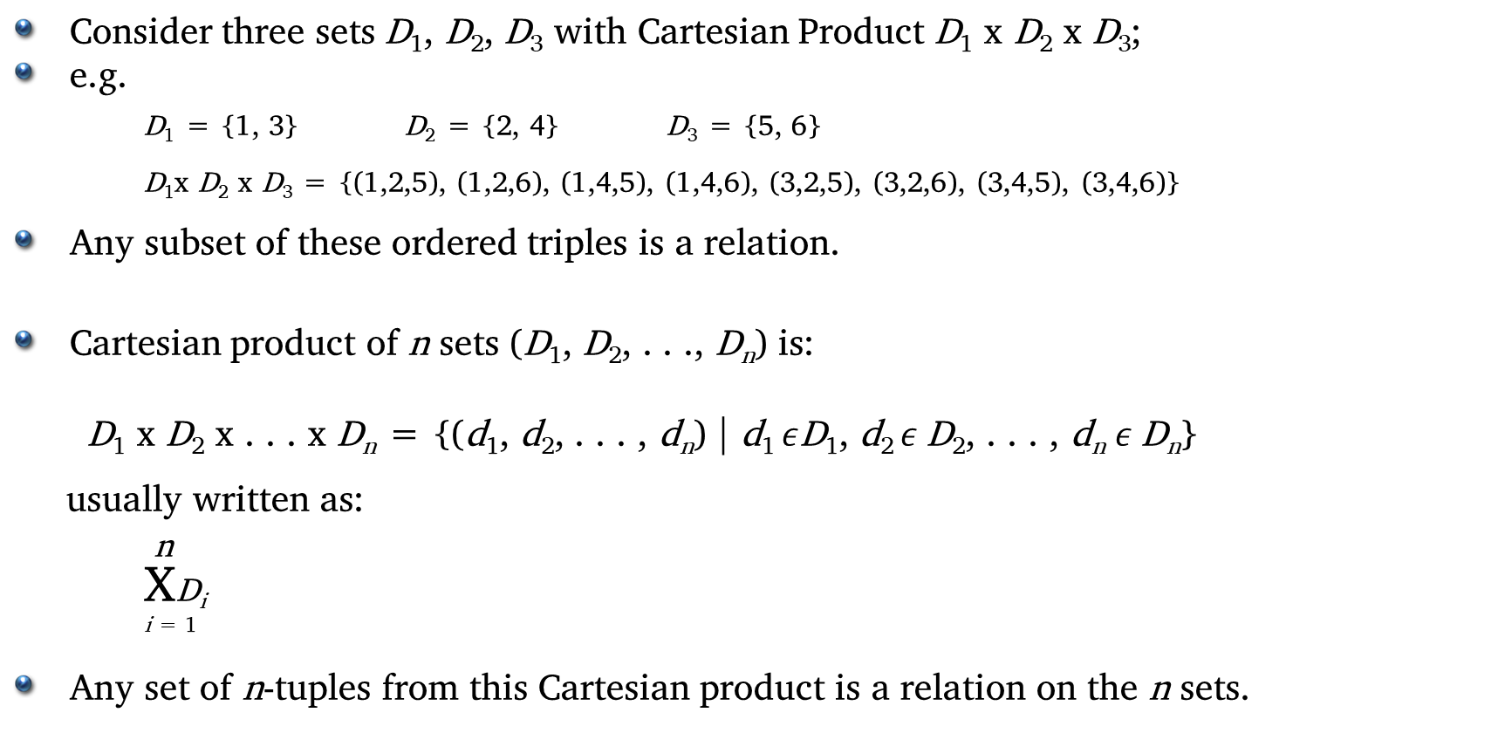
Mathematical Definition of Relation
Consider three sets D₁, D₂, D₃ with Cartesian Product D₁ x D₂ x D₃;
e.g.
D₁ = {1, 3} D₂ = {2, 4} D₃ = {5, 6}
D₁x D₂ x D₃ = {(1,2,5), (1,2,6), (1,4,5), (1,4,6), (3,2,5), (3,2,6), (3,4,5), (3,4,6)}
Any subset of these ordered triples is a relation.
Cartesian product of n sets (D₁, D₂, . . ., D_{n}) is:
D₁ x D₂ x . . . x D_{n} = {(d₁, d₂, . . . , d_{n}) | d₁ $ε$D₁, d₂ $ε$D₂, . . . , d_{n} $ε$D_{n}}
usually written as:
n
XD_{i}
^{i = 1}
Any set of n-tuples from this Cartesian product is a relation on the n sets.

Slide 9
Database Relations
Relation schema
Named relation defined by a set of attribute and domain name pairs.
Relational database schema
Set of relation schemas, each with a distinct name.

Slide 10
Properties of Relations
Relation name is distinct from all other relation names in relational schema.
Each cell of relation contains exactly one atomic (single) value.
Each attribute has a distinct name.
Values of an attribute are all from the same domain.
Each tuple is distinct; there are no duplicate tuples.
Order of attributes has no significance.
Order of tuples has no significance, theoretically.

Slide 11
Relational Keys
Superkey
An attribute, or set of attributes, that uniquely identifies a tuple within a relation.
Candidate Key
Superkey (K) such that no proper subset is a superkey within the relation.
In each tuple of R, values of K uniquely identify that tuple (uniqueness).
No proper subset of K has the uniqueness property (irreducibility).
Primary Key
Candidate key selected to identify tuples uniquely within relation.
Alternate Keys
Candidate keys that are not selected to be primary key.
Foreign Key
Attribute, or set of attributes, within one relation that matches candidate key of some (possibly same) relation.

Slide 12
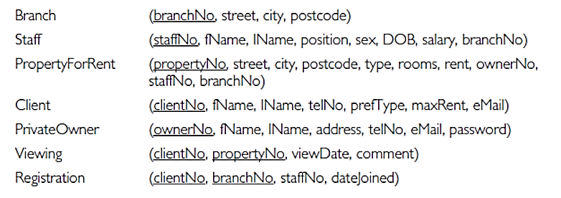
Representing Relational Database Schemas
The relational schema for part of the DreamHome case study is:

Slide 13
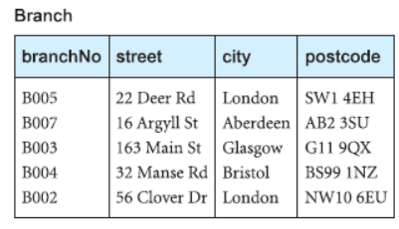
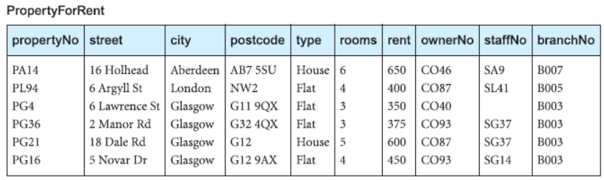
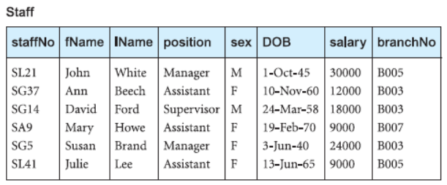
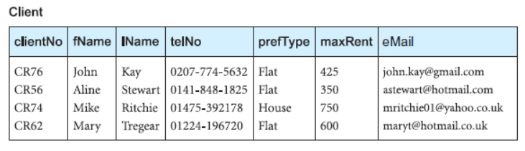
Instance of relational schema

Slide 14
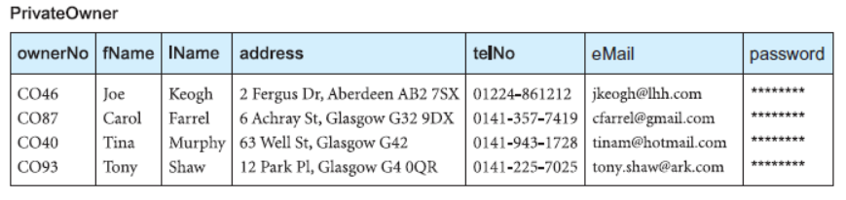
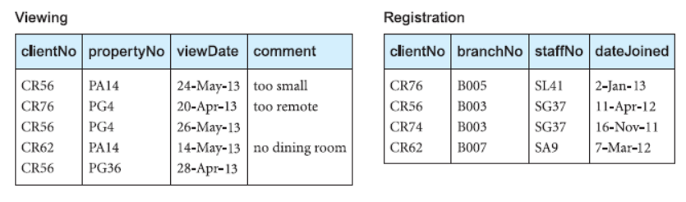
Instance of relational schema

Slide 15
Integrity Constraints
Null
Represents value for an attribute that is currently unknown or not applicable for tuple.
Deals with incomplete or exceptional data.
Represents the absence of a value and is not the same as zero or spaces, which are values
Entity Integrity
In a base relation, no attribute of a primary key can be null.
Referential Integrity
If foreign key exists in a relation, either foreign key value must match a candidate key value of some tuple in its home relation or foreign key value must be wholly null.
General Constraints
Additional rules specified by users or database administrators that define or constrain some aspect of the enterprise.

Slide 16
Views
Base Relation
Named relation corresponding to an entity in conceptual schema, whose tuples are physically stored in database.
View
Dynamic result of one or more relational operations operating on base relations to produce another relation
A virtual relation that does not necessarily actually exist in the database but is produced upon request, at time of request.
Contents of a view are defined as a query on one or more base relations.
Views are dynamic, meaning that changes made to base relations that affect view attributes are immediately reflected in the view.

Slide 17
Purpose of Views
Provides powerful and flexible security mechanism by hiding parts of database from certain users.
Permits users to access data in a customized way, so that same data can be seen by different users in different ways, at same time.
Can simplify complex operations on base relations.

Slide 18
Updating Views
All updates to a base relation should be immediately reflected in all views that reference that base relation.
If view is updated, underlying base relation should reflect change.
There are restrictions on types of modifications that can be made through views:
Updates are allowed if query involves a single base relation and contains a candidate key of base relation.
Updates are not allowed involving multiple base relations.
Updates are not allowed involving aggregation or grouping operations.
Classes of views are defined as:
theoretically not updateable;
theoretically updateable;
partially updateable.

Slide 19
Relational Algebra and Relational Calculus

Slide 20
Introduction
Relational algebra and relational calculus are formal languages associated with the relational model.
Informally, relational algebra is a (high-level) procedural language and relational calculus a non-procedural language.
However, formally both are equivalent to one another.
A language that produces a relation that can be derived using relational calculus is relationally complete.

Slide 21
Relational Algebra
Relational algebra operations work on one or more relations to define another relation without changing the original relations.
Both operands and results are relations, so output from one operation can become input to another operation.
Allows expressions to be nested, just as in arithmetic. This property is called closure.
Five basic operations in relational algebra: Selection, Projection, Cartesian product, Union, and Set Difference.
These perform most of the data retrieval operations needed.
Also have Join, Intersection, and Division operations, which can be expressed in terms of 5 basic operations

Slide 22
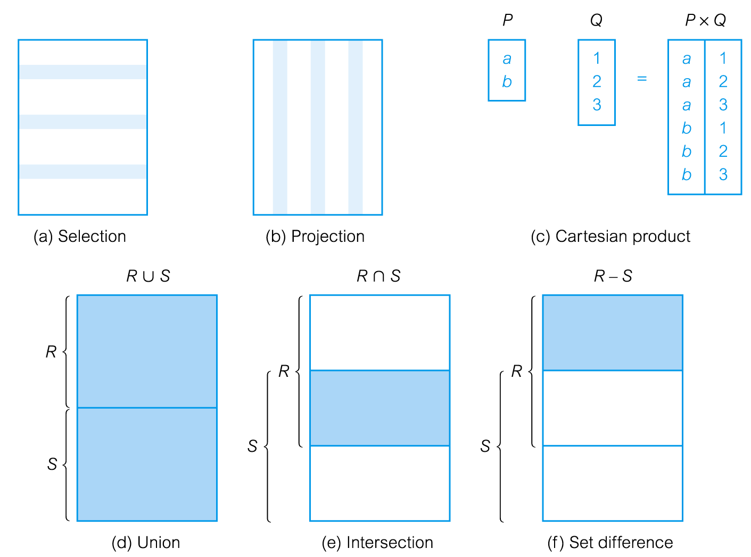
Relational Algebra Operations

Slide 23
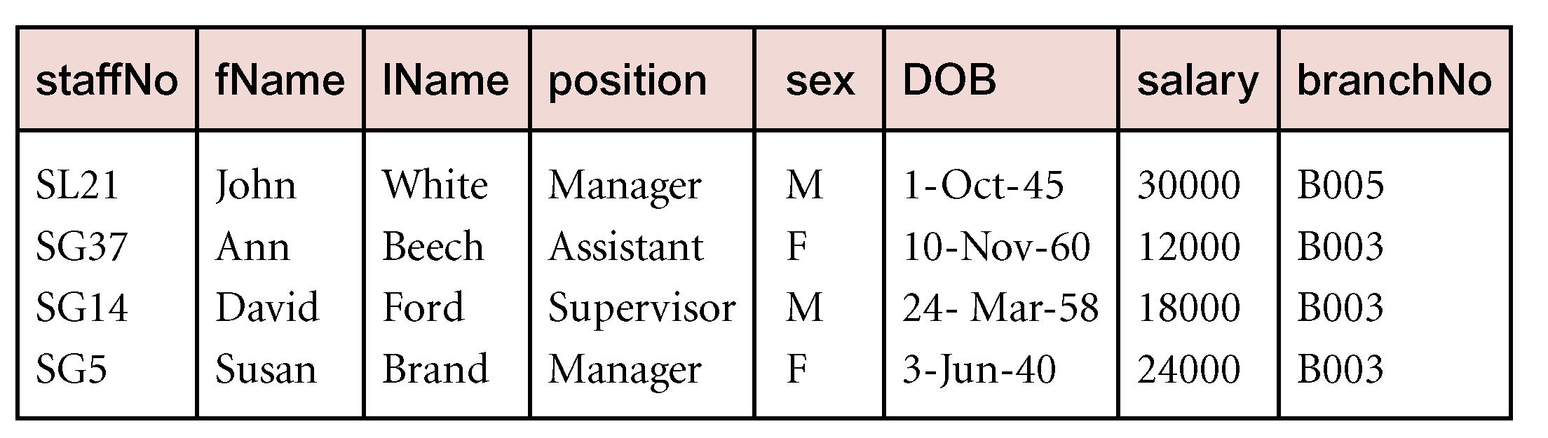
Selection (or Restriction)
σ_{predicate} (R)
Works on a single relation R and defines a relation that contains only those tuples (rows) of R that satisfy the specified condition (predicate).
Example:
List all staff with a salary greater than £10,000.
σ_{salary > 10000} (Staff)

Slide 24
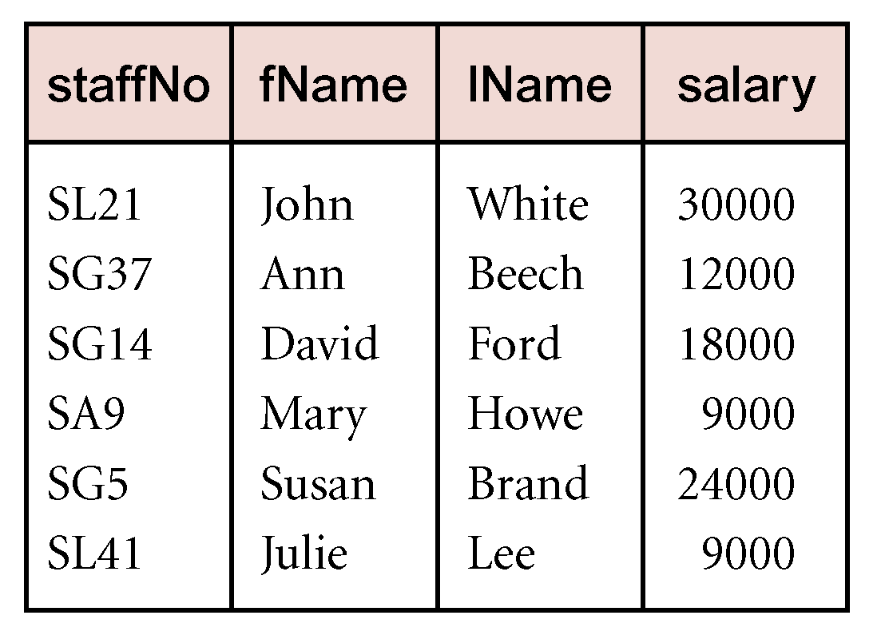
Projection
Π_{col1, . . . , coln}(R)
Works on a single relation R and defines a relation that contains a vertical subset of R, extracting the values of specified attributes and eliminating duplicates.
Example:
Produce a list of salaries for all staff, showing only staffNo, fName, lName, and salary details.
Π_{staffNo, fName, lName, salary}(Staff)

Slide 25
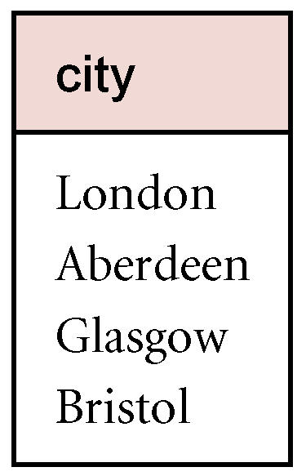
Union
R ∪ S
Union of two relations R and S defines a relation that contains all the tuples of R, or S, or both R and S, duplicate tuples being eliminated.
R and S must be union-compatible.
If R and S have I and J tuples, respectively, union is obtained by concatenating them into one relation with a maximum of (I + J) tuples.
Example:
List all cities where there is either a branch office or a property for rent.
Π_{city}(Branch) ∪ Π_{city}(PropertyForRent)

Slide 26
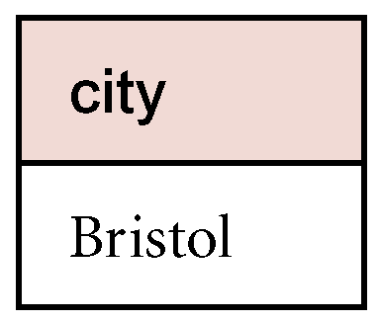
Set Difference
R – S
Defines a relation consisting of the tuples that are in relation R, but not in S.
R and S must be union-compatible.
Example:
List all cities where there is a branch office but no properties for rent.
Π_{city}(Branch) – Π_{city}(PropertyForRent)

Slide 27
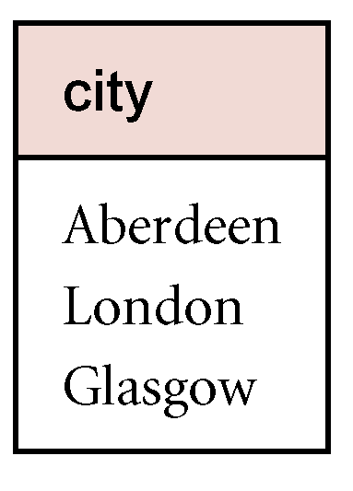
Intersection
R ∩ S
Defines a relation consisting of the set of all tuples that are in both R and S.
R and S must be union-compatible.
Expressed using basic operations:
R ∩ S = R – (R – S)
Example:
List all cities where there is both a branch office and at least one property for rent.
Π_{city}(Branch) ∩ Π_{city}(PropertyForRent)

Slide 28
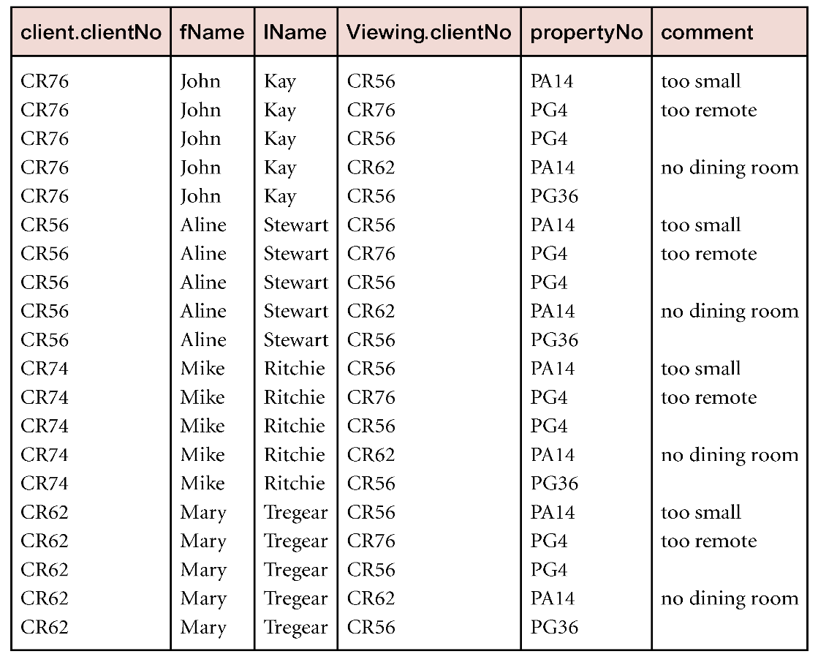
Cartesian product
R X S
Defines a relation that is the concatenation of every tuple of relation R with every tuple of relation S.
Example:
List the names and comments of all clients who have viewed a property for rent.
(Π_{clientNo, fName, lName}(Client)) X (Π_{clientNo, propertyNo, comment} (Viewing))

Slide 29
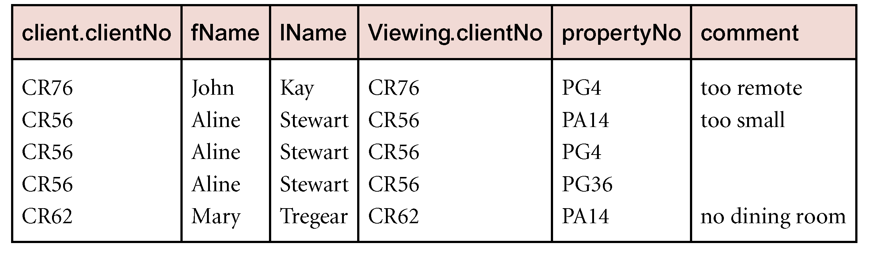
Cartesian product and Selection
Example:
Use selection operation to extract those tuples where Client.clientNo = Viewing.clientNo.
sClient.clientNo = Viewing.clientNo((∏_{clientNo, fName, lName}(Client)) Χ (∏_{clientNo, propertyNo, comment}(Viewing)))
Cartesian product and Selection can be reduced to a single operation called a Join.

Slide 30
Join Operations
Join is a derivative of Cartesian product.
Equivalent to performing a Selection, using join predicate as selection formula, over Cartesian product of the two operand relations.
One of the most difficult operations to implement efficiently in an RDBMS and one reason why RDBMSs have intrinsic performance problems.
Various forms of join operation
Theta join
Equijoin (a particular type of Theta join)
Natural join
Outer join
Semijoin

Slide 31
Theta join (θ-join)
R _{F}S
Defines a relation that contains tuples satisfying the predicate F from the Cartesian product of R and S.
The predicate F is of the form R.a_{i} θ S.b_{i} where θ may be one of the comparison operators (<, ≤, >, ≥, =, ≠).
Can rewrite Theta join using basic Selection and Cartesian product operations.
R _{F}S = σ_{F}(R Χ S)
Degree of a Theta join is sum of degrees of the operand relations R and S. If predicate F contains only equality (=), the term Equijoin is used.

Slide 32
Equijoin
List the names and comments of all clients who have viewed a property for rent.
(Π_{clientNo, fName, lName}(Client)) Client.clientNo = Viewing.clientNo (Π_{clientNo, propertyNo, comment}(Viewing))

Slide 33
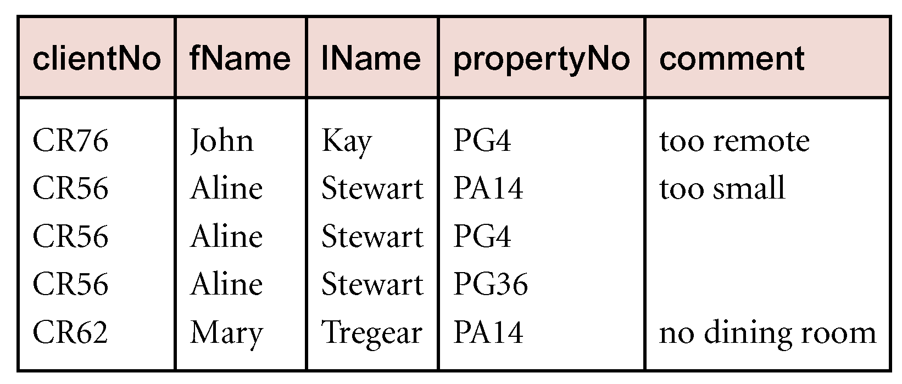
Natural join
R S
An Equijoin of the two relations R and S over all common attributes x. One occurrence of each common attribute is eliminated from the result.
List the names and comments of all clients who have viewed a property for rent.
(Π_{clientNo, fName, lName}(Client))
(Π_{clientNo, propertyNo, comment}(Viewing))
Example 1:
List the names and comments of all clients who have viewed a property for rent.
(Π_{clientNo, fName, lName}(Client)) (Π_{clientNo, propertyNo, comment}(Viewing))

Slide 34
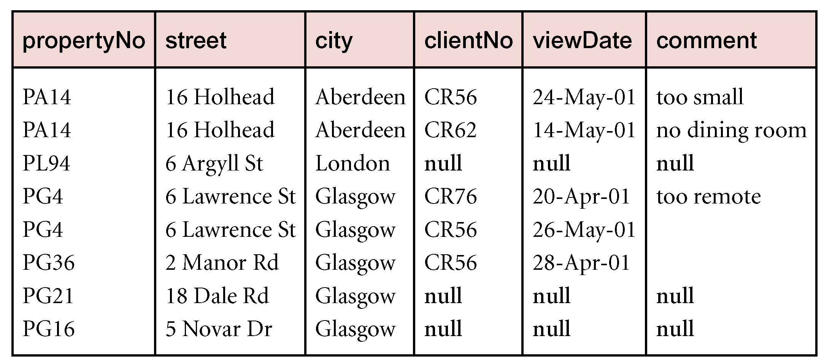
Outer join
To display rows in the result that do not have matching values in the join column, use Outer join.
R S
(Left) outer join is join in which tuples from R that do not have matching values in common columns of S are also included in result relation.
Example:
Produce a status report on property viewings.
Π_{propertyNo, street, city}(PropertyForRent) Viewing

Slide 35
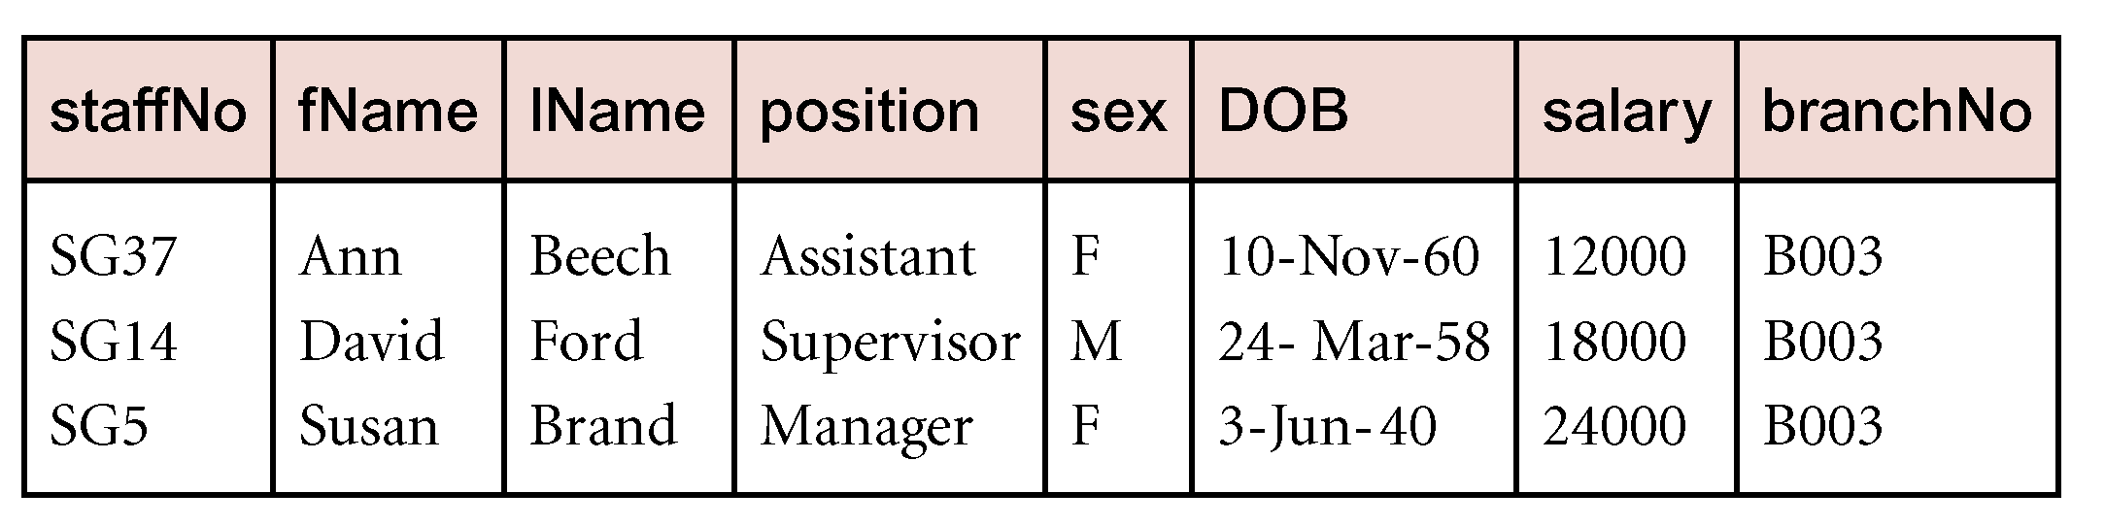
Semijoin
R _{F} S
Defines a relation that contains the tuples of R that participate in the join of R with S.
Can rewrite Semijoin using Projection and Join:
R _{F} S = Π_{A}(R _{F} S)
Example:
List complete details of all staff who work at the branch in Glasgow
Staff _{Staff.branchNo=Branch.branchNo}(σ_{city=‘Glasgow’}(Branch))

Slide 36
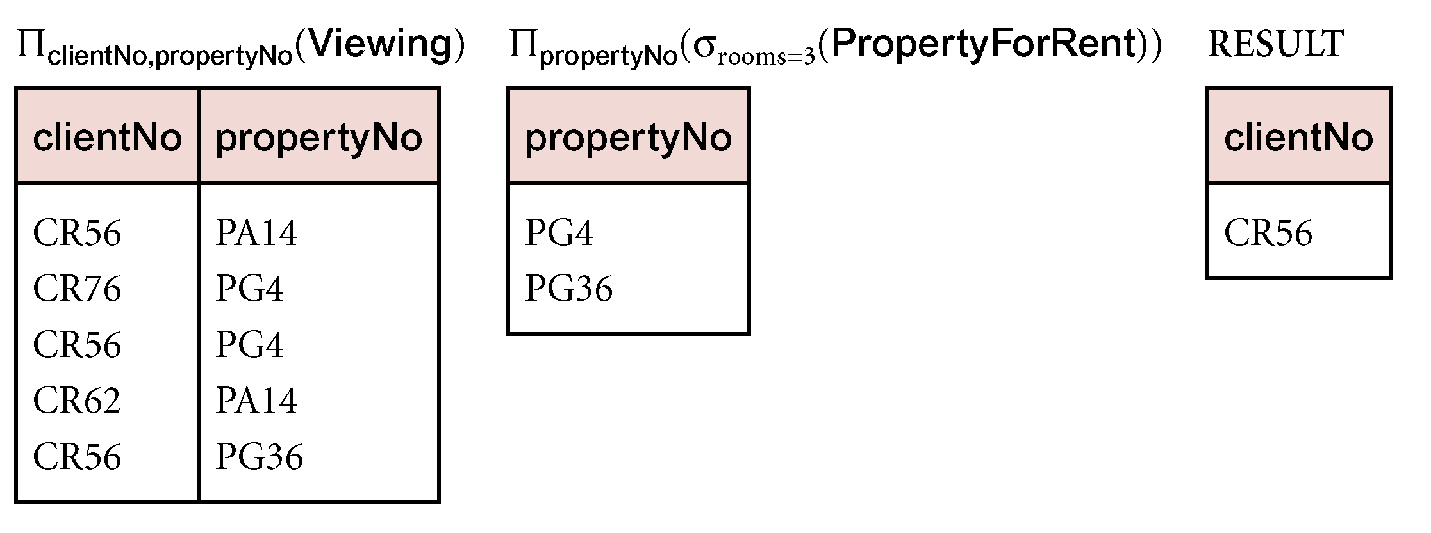
Division
R ÷ S
Defines a relation over the attributes C that consists of set of tuples from R that match combination of every tuple in S.
Expressed using basic operations:
T₁ ← Π_{C}(R)
T₂ ← Π_{C}((S X T₁) – R)
T ← T₁ – T₂
Example:
Identify all clients who have viewed all properties with three rooms.
(Π_{clientNo, propertyNo}(Viewing)) ÷ (Π_{propertyNo}(σ_{rooms = 3} (PropertyForRent)))

Slide 37
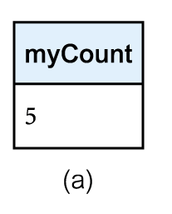
Aggregate Operations
ℑ_{AL}(R)
Applies aggregate function list, AL, to R to define a relation over the aggregate list.
AL contains one or more (<aggregate_function>, <attribute>) pairs .
Main aggregate functions are: COUNT, SUM, AVG, MIN, and MAX.
Example:
How many properties cost more than £350 per month to rent?
ρ_{R}(myCount) ℑ_{COUNT} _{propertyNo} (σ_{rent > 350} (PropertyForRent))

Slide 38
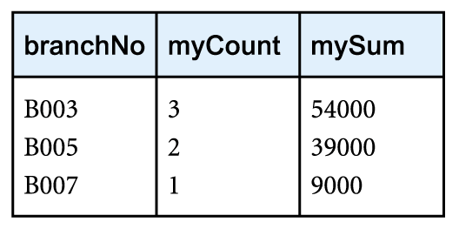
Grouping Operation
_{GA}ℑ_{AL}(R)
Groups tuples of R by grouping attributes, GA, and then applies aggregate function list, AL, to define a new relation.
AL contains one or more (<aggregate_function>, <attribute>) pairs.
Resulting relation contains the grouping attributes, GA, along with results of each of the aggregate functions.
Example:
Find the number of staff working in each branch and the sum of their salaries.
ρ_{R}(branchNo, myCount, mySum) _{branchNo} ℑ _{COUNT staffNo,} _{SUM salary} (Staff)

Slide 39
Relational Calculus
Relational calculus query specifies what is to be retrieved rather than how to retrieve it.
No description of how to evaluate a query.
In first-order logic (or predicate calculus), predicate is a truth-valued function with arguments.
When we substitute values for the arguments, function yields an expression, called a proposition, which can be either true or false.
If predicate contains a variable (e.g. ‘x is a member of staff’), there must be a range for x.
When we substitute some values of this range for x, proposition may be true; for other values, it may be false.
When applied to databases, relational calculus has forms: tuple and domain.

Slide 40
Tuple Relational Calculus
Interested in finding tuples for which a predicate is true. Based on use of tuple variables.
Tuple variable is a variable that ‘ranges over’ a named relation: i.e., variable whose only permitted values are tuples of the relation.
Specify range of a tuple variable S as the Staff relation as:
Staff(S)
To find set of all tuples S such that P(S) is true:
{S | P(S)}
Examples:
To find details of all staff earning more than £10,000:
{S | Staff(S) ∧ S.salary > 10000}
To find a particular attribute, such as salary, write:
{S.salary | Staff(S) ∧ S.salary > 10000}

Slide 41
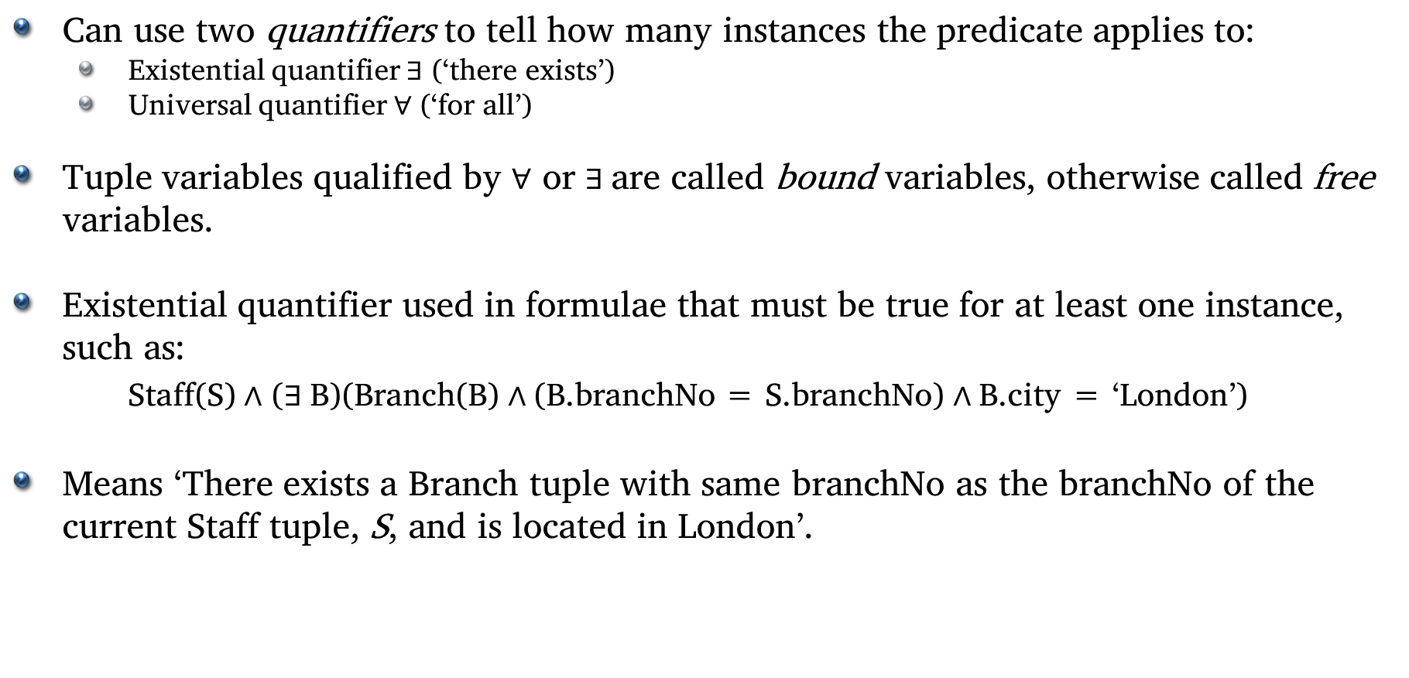
Tuple Relational Calculus
Can use two quantifiers to tell how many instances the predicate applies to:
Existential quantifier $∃$ (‘there exists’)
Universal quantifier $∀$ (‘for all’)
Tuple variables qualified by $∀$ or $∃$are called bound variables, otherwise called free variables.
Existential quantifier used in formulae that must be true for at least one instance, such as:
Staff(S) $∧$ ($∃$B)(Branch(B) $∧$(B.branchNo = S.branchNo) $∧$B.city = ‘London’)
Means ‘There exists a Branch tuple with same branchNo as the branchNo of the current Staff tuple, S, and is located in London’.

Slide 42
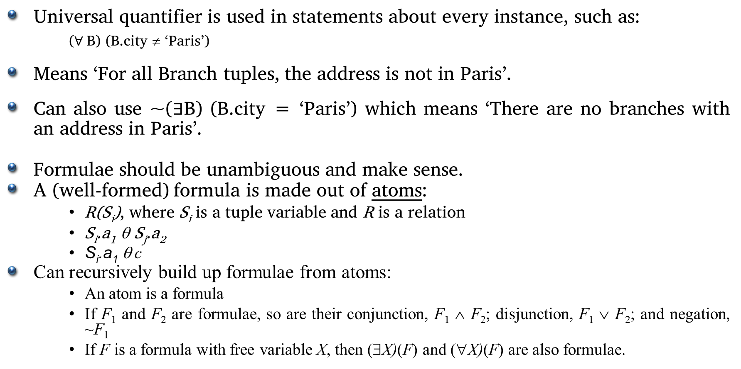
Tuple Relational Calculus
Universal quantifier is used in statements about every instance, such as:
($∀$B) (B.city ≠ ‘Paris’)
Means ‘For all Branch tuples, the address is not in Paris’.
Can also use ~($∃$B) (B.city = ‘Paris’) which means ‘There are no branches with an address in Paris’.
Formulae should be unambiguous and make sense.
A (well-formed) formula is made out of atoms:
R(S_{i}), where S_{i} is a tuple variable and R is a relation
S_{i}.a₁ θ S_{j}.a₂
S_{i}.a₁ θ c
Can recursively build up formulae from atoms:
An atom is a formula
If F₁ and F₂ are formulae, so are their conjunction, F₁ ∧ F₂; disjunction, F₁ ∨ F₂; and negation, ~F₁
If F is a formula with free variable X, then (∃X)(F) and (∀X)(F) are also formulae.

Slide 43
Tuple Relational Calculus
Examples:
List the names of all managers who earn more than £25,000.
{S.fName, S.lName | Staff(S) ∧ S.position = ‘Manager’ ∧ S.salary > 25000}
List the staff who manage properties for rent in Glasgow.
{S | Staff(S) ∧ (∃P) (PropertyForRent(P) ∧ (P.staffNo = S.staffNo) ∧ P.city = ‘Glasgow’)}
List the names of staff who currently do not manage any properties.
{S.fName, S.lName | Staff(S) ∧ (~(∃P) (PropertyForRent(P)∧(S.staffNo = P.staffNo)))}
Or
{S.fName, S.lName | Staff(S) ∧ ((∀P) (~PropertyForRent(P) ∨ ~(S.staffNo = P.staffNo)))}

Slide 44
Tuple Relational Calculus
Examples:
List the names of clients who have viewed a property for rent in Glasgow.
{C.fName, C.lName | Client(C) ∧ ((∃V)(∃P)
(Viewing(V) ∧ PropertyForRent(P) ∧
(C.clientNo = V.clientNo) ∧
(V.propertyNo=P.propertyNo) ∧
P.city =‘Glasgow’))}

Slide 45
Tuple Relational Calculus
Expressions can generate an infinite set. For example:
{S | ~Staff(S)}
To avoid this, add restriction that all values in result must be values in the domain of the expression.

Slide 46
Domain Relational Calculus
Uses variables that take values from domains instead of tuples of relations.
If F(d₁, d₂, . . . , d_{n}) stands for a formula composed of atoms and d₁, d₂, . . . , d_{n} represent domain variables, then:
{d₁, d₂, . . . , d_{n} | F(d₁, d₂, . . . , d_{n})}
is a general domain relational calculus expression.
Example:
Find the names of all managers who earn more than £25,000.
{fN, lN | (∃sN, posn, sex, DOB, sal, bN)
(Staff (sN, fN, lN, posn, sex, DOB, sal, bN) ∧
posn = ‘Manager’ ∧ sal > 25000)}

Slide 47
Domain Relational Calculus
Examples:
List the staff who manage properties for rent in Glasgow.
{sN, fN, lN, posn, sex, DOB, sal, bN (∃sN1,cty) (Staff(sN,fN,lN,posn,sex,DOB,sal,bN) ∧
PropertyForRent(pN, st, cty, pc, typ, rms, rnt, oN, sN1, bN1) ∧ (sN=sN1) ∧ cty=‘Glasgow’)}
List the names of staff who currently do not manage any properties for rent.
{fN, lN | (∃sN) (Staff(sN,fN,lN,posn,sex,DOB,sal,bN) ∧ (~(∃sN1) (PropertyForRent(pN, st, cty, pc, typ, rms, rnt, oN, sN1, bN1) ∧ (sN=sN1))))}

Slide 48
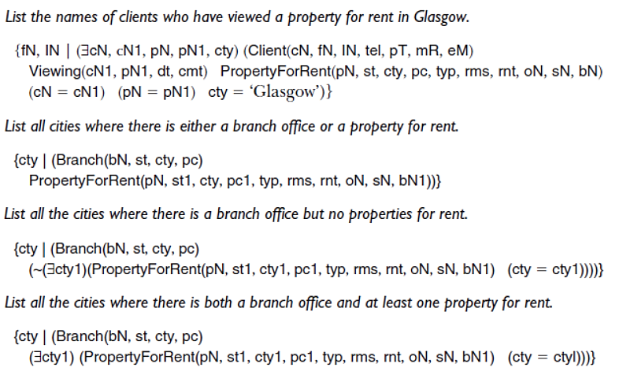
Domain Relational Calculus (More examples)

Slide 49
Domain Relational Calculus
When restricted to safe expressions, domain relational calculus is equivalent to tuple relational calculus restricted to safe expressions, which is equivalent to relational algebra.
Means every relational algebra expression has an equivalent relational calculus expression, and vice versa.

Slide 50
Other Languages
Transform-oriented languages are non-procedural languages that use relations to transform input data into required outputs (e.g. SQL).
Graphical languages provide user with picture of the structure of the relation. User fills in example of what is wanted, and system returns required data in that format (e.g. QBE).
4GLs can create complete customized application using limited set of commands in a user-friendly, often menu-driven environment.
Some systems accept a form of natural language, sometimes called a 5GL, although this development is still at an early stage.

